Slide 1
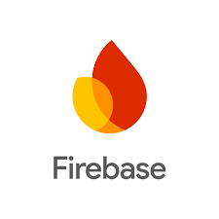
Evaluating The Security Of Firebase-Based Applications Against Token Theft
An Insight into Vulnerabilities, and Mitigations
presented by
BHAVAJNA MADIVADA

Slide 2
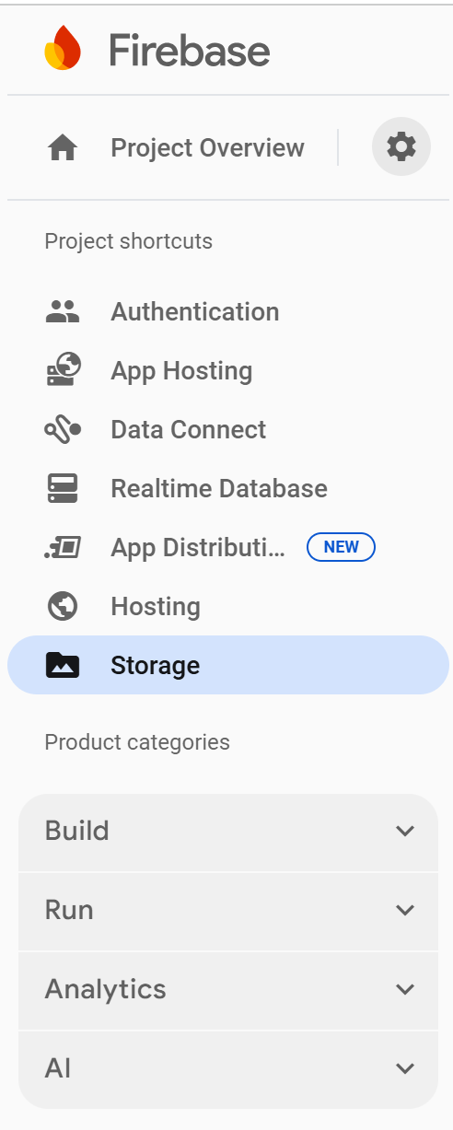
Key Services:
What is Firebase?
Firebase is a Backend-as-a-Service (BaaS) platform developed by Google that provides developers with a suite of cloud-based tools to build and manage applications without needing to manage server infrastructure.
How Firebase Authentication Works ?
User Authentication Process:
User logs in using email/password, phone, Google, Facebook, etc.
Firebase returns a JWT-based ID Token (and refresh token).
ID Token is sent with each request to verify identity.
Token Types:
ID Token: Authenticates users (short lifespan)
Refresh Token: Issues new ID tokens (long lifespan)

Slide 3
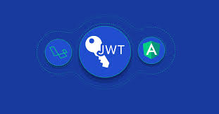
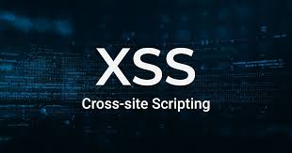
Common Vulnerabilities leading to Token Theft
Insecure Token Storage:
Storing tokens in localStorage or sessionStorage (accessible via JavaScript)
Cross-Site Scripting (XSS):
Malicious script can access and steal tokens stored on the client-side
Misconfigured Firebase Security Rules:
Rules like ".read": true, ".write": true make data publicly accessible

Slide 4
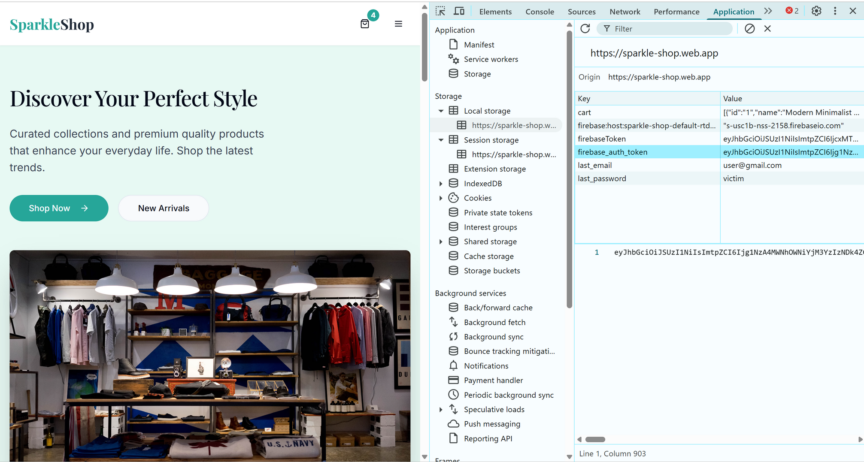
Insecure Token Storage
Storing tokens in localStorage or sessionStorage exposes them to JavaScript attacks like XSS, risking token theft.

Slide 5
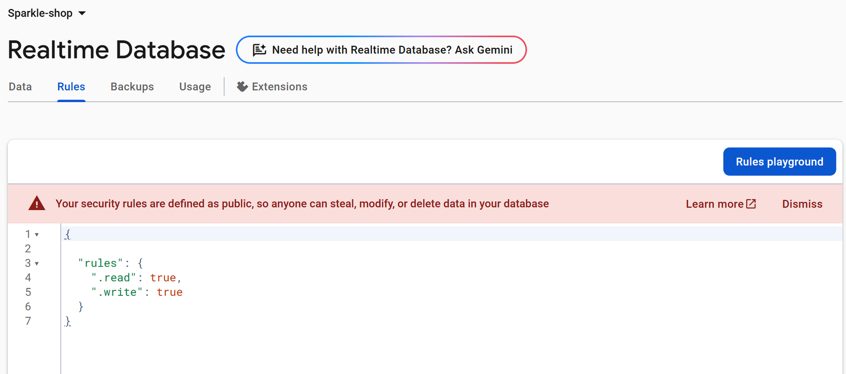
Misconfigured Firebase Security Rules

Slide 6
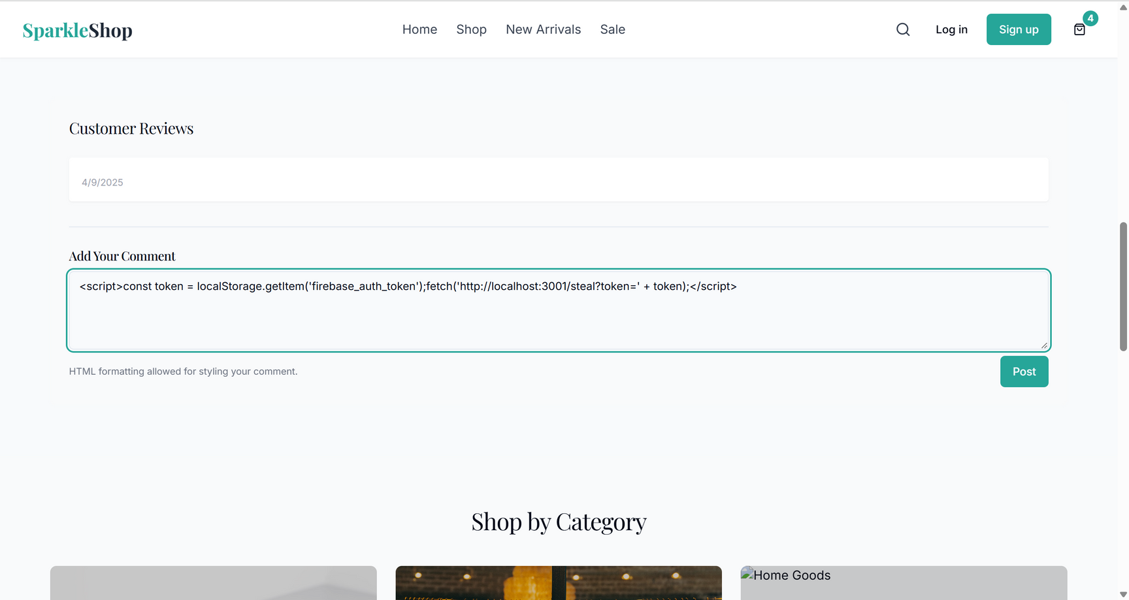
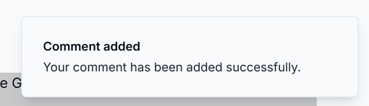
Cross-Site Scripting (XSS):
Malicious script can access and steal tokens stored on the client-side

Slide 7
Impacts of Token Theft
Unauthorized Access to User Accounts
Attackers can gain control over user accounts and impersonate legitimate users.
Data leakage or deletion
Sensitive personal, financial, or business data may be exposed, stolen, or permanently deleted.
Fraudulent activities and transactions
Unauthorized purchases, fund transfers, or malicious actions can be performed using stolen credentials.
Service abuse using hijacked credentials
Attackers may exploit premium services, system resources without the owner’s consent.
Trust and reputation loss
Security breaches damage the reputation of the service provider and erode user trust.

Slide 8
Mitigation Strategies
Secure Storage:
Use httpOnly, Secure Cookies for storing tokens
Avoid localStorage/sessionStorage for sensitive tokens
Implement Strong Security Rules:
Use Firebase Realtime Database and Firestore rules
Restrict read/write access based on authenticated user IDs
Enforce HTTPS Everywhere:
Avoid unencrypted traffic
Sanitize Inputs and Prevent XSS:
Validate and sanitize all user inputs on the client and server-side
Token Expiry & Revocation:
Implement short-lived tokens
Provide a way to revoke tokens upon suspicious activities
Restrict CORS Policies:
Limit allowed origins to trusted domains only

Slide 9

THANK YOU

